Slide 1








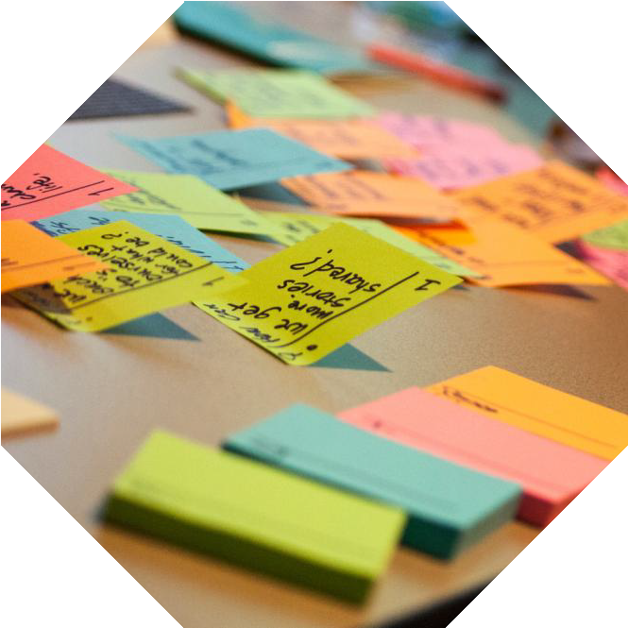



AI DSA Tutor
P R E S E N T A T I O N
2 0 2 6
Student Name
Deeksha V
Misbah Fathima Priyanka
Student Email
Guide
Gunjan Mishra [Subject Matter Expert (AI&ML)]
deeksha31005@gmail.com misbahfathima785@gmail.com p70669355@gmail.com

Slide 2

OUTLINE
Abstract of the Project
Problem Statement
Proposed Solution
System Architecture
Live Demo of the Project
Embedded Video of Project
Conclusion
Future Scope

Slide 3
Abstract
AI DSA Tutor
AI-Powered DSA Learning & Practice
An interactive platform for learning and practicing Data Structures & Algorithms through
problems and progressive hints.
Uses a Machine Learning Decision Tree to predict problem difficulty based on key problem features.
Provides Easy, Medium & Hard problems across 11 DSA topics with AI confidence scores.
Our approach: Practice → Get Hints → Understand → Improve
DSA Problem → AI Prediction → Progressive Hints → Better Learning

Slide 4


Problem Statement
DSA is essential for placements—but students often struggle to learn it effectively.
Today's DSA practice:
Problems
Solutions
Difficulty Levels
Missing
Personalized guidance
Step-by-step hints Understanding-based learning AI-powered difficulty prediction
Need: A platform that helps students Practice → Get Hints
→ Understand → Improve.

Slide 5
The Learning Gap
A student may solve a DSA problem, but without proper guidance, they may not understand
how to approach it or improve their problem-solving skills.
Bottom learning chain:
DSA Problem → Attempt → Difficulty Assessment → Progressive Hints → Understanding →
Improved Problem Solving
One Killer Line
“The problem is not that students lack DSA resources. The problem is that they lack the right guidance at the right time.”

Slide 6

Proposed Solution
AI DSA Tutor provides an intelligent, guided environment for effective DSA learning.
Curated DSA problems across multiple topics
AI-based difficulty prediction
Progressive, personalized hints
Step-by-step problem-solving guidance
AI confidence score for predictions
Practice → Predict → Guide → Understand →
Improve
Project website Link : https://ai-dsa-tutor-xttcrtgy7kavje5n62mypq.streamlit.app/

Slide 7




System Architecture
2. Problem & Hint Management
Stores DSA problems, categories, solutions, and progressive hints.
4. Learning & Feedback System
Provides hints and guidance to help users understand problems and improve problem-solving skills.
1. User Interface
Problem browsing, topic selection, difficulty levels, and interactive learning interface.
3. AI/ML Prediction Engine
Uses a Decision Tree model to analyse problem features and predict difficulty with a confidence score.

Slide 8



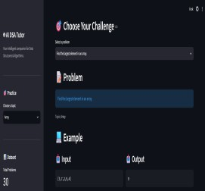

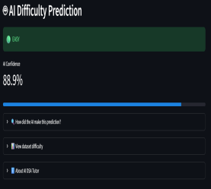
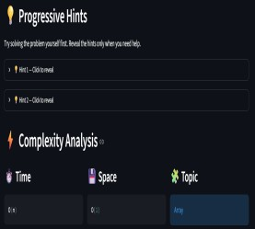


Live Demo of Project
Here’s the list of some demo of the projects -
Demo 3
AI Difficulty
Prediction
Show the ML-predicted difficulty, confidence score, and problem features.
Demo 1
Explore DSA Problems Select a topic and choose from categorized DSA problems.
Demo 2
Progressive Hints Reveal hints step-by-step to understand the problem without directly seeing the solution.

Slide 9

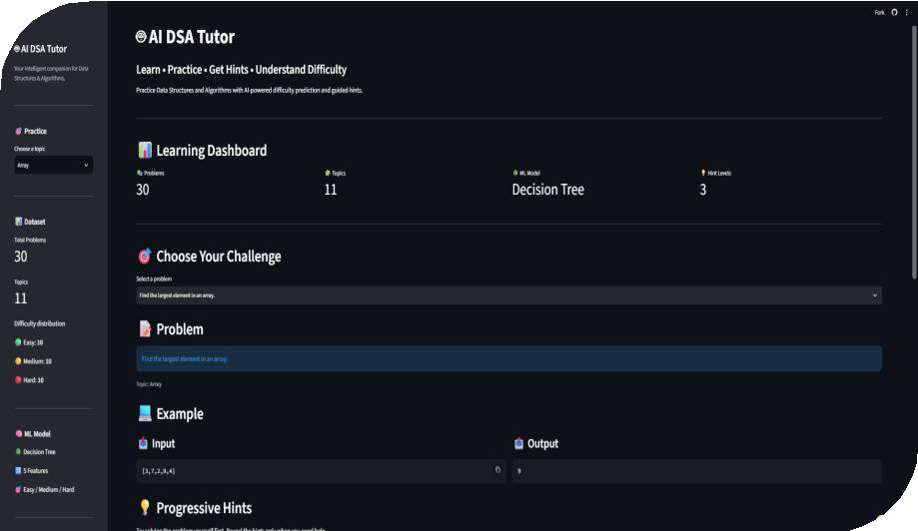
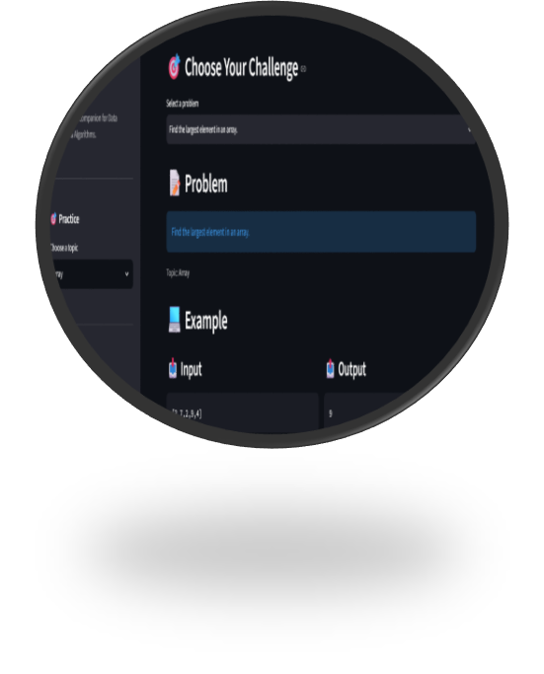

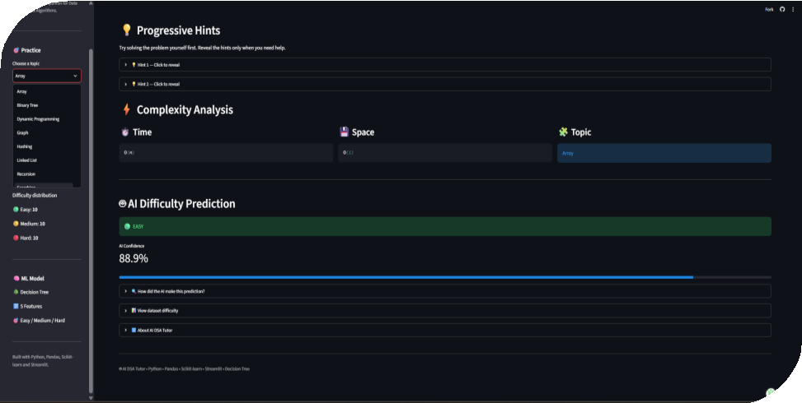
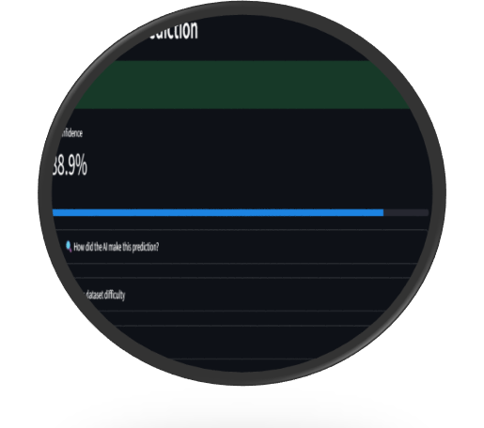

Slide 10
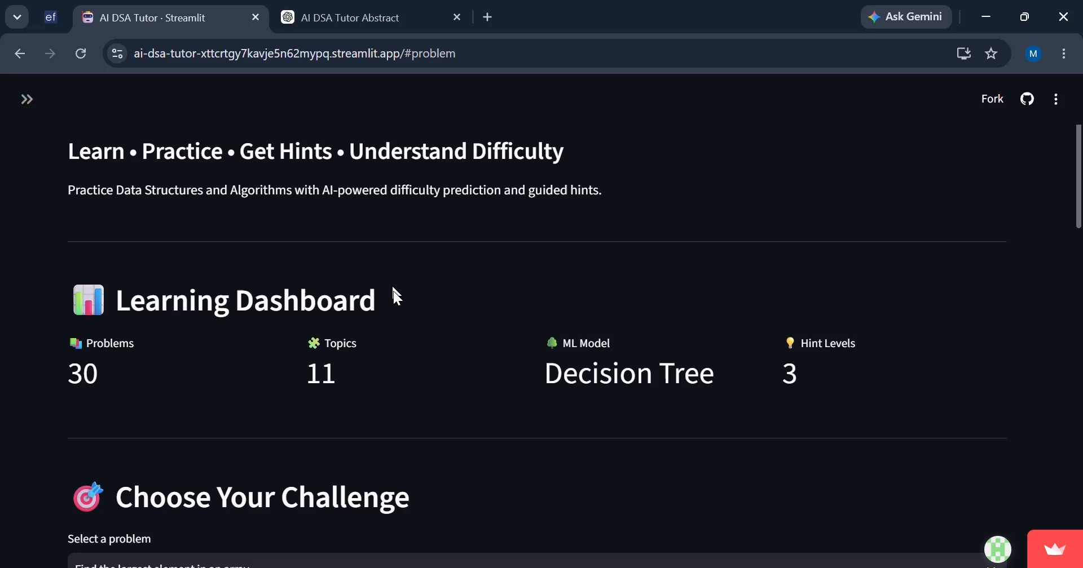
Video of Project Demo

Slide 11

Conclusion
AI DSA Tutor addresses a key challenge in DSA learning—helping students practice effectively while developing independent problem-solving skills.
By combining AI-powered difficulty prediction with progressive hints, the platform provides personalized and engaging learning support.
Our vision:
Practice. Get Guided. Understand. Improve.

Slide 12

Future Scope
Expand the platform with more DSA topics, problems, and personalized learning paths.
Introduce AI-generated hints and adaptive recommendations based on individual learning progress.
Add code evaluation and performance analysis to provide
instant feedback on student solutions.
Integrate progress tracking, achievements, and personalized dashboards for continuous learning.
“The future of DSA learning is not just solving more problems—it is helping every student solve problems smarter.”

Slide 13
Thank You

